Slide 1



Final project proposal
Predicting College Admission Based on High School Data
Team ERALASH

Slide 2
















TEAM MEMBERS
“The strength of the team is each individual member. The strength of each member is the team.”
- Phil Jackson
Novikova Anna
Ochgerel Buyandelger
12230292
12230296
ERALASH
Grishaeva Arina
Purev Nomin Erdene
12230285
12230265

Slide 3





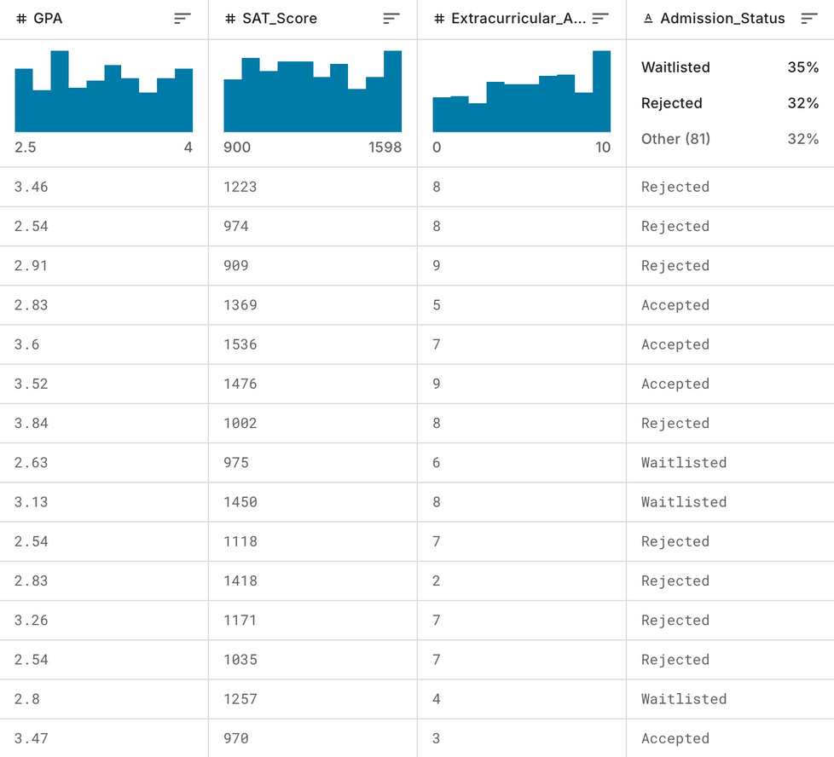







PREDICTING COLLEGE ADMISSION BASED ON HIGH SCHOOL DATA
Overview
Dataset
KAGGLE.COM
Objective
01
To develop a predictive model using student academic and extracurricular data to estimate the likelihood of college admission or scholarship eligibility.
To identify key factors influencing college decisions.
Problem Statement
02
Students and institutions face uncertainty in the college admission process.
Predicting admission likelihood can help applicants set realistic goals and optimize their applications.
Use Case
03
For students: guidance on where to apply.
For counselors: personalized advice using data-backed predictions.
https://www.kaggle.com/datasets/amanace/student-admission-dataset

Slide 4
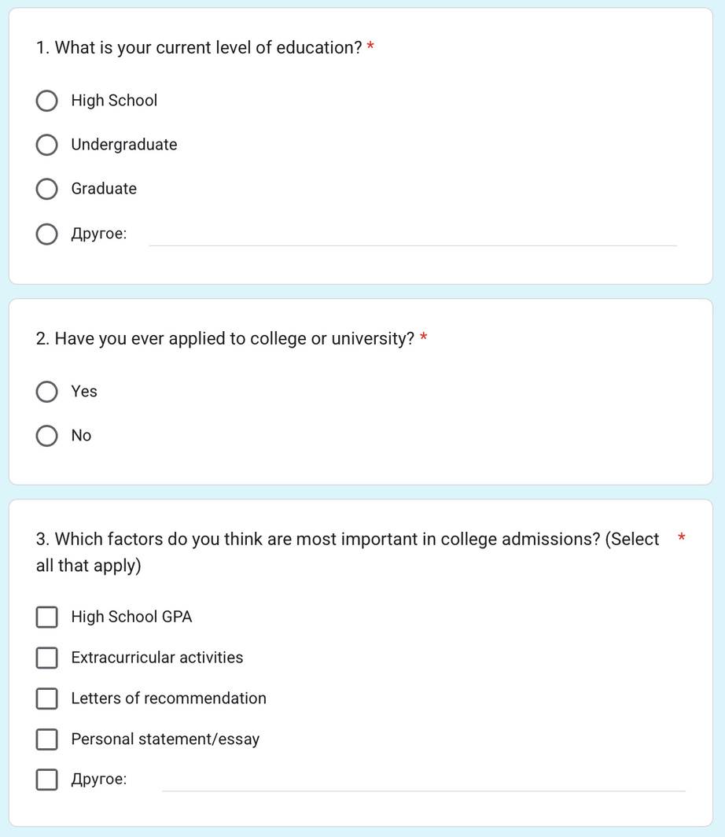




2. Survey
“The important thing is not to stop questioning.”
– Albert Einstein
SURVEY PLAN
1
2
Target
Purpose
30+ high school or college students.
Understand applicant expectations, motivations, and perceptions.
https://docs.google.com/forms/d/e/1FAIpQLSdYokubvdc2GPzOLwjh-Kc3niscLyYrsS5dzn6Ftysn7aojWA/viewform?usp=header

Slide 5










3. Methodology
Visualizations & Insights
Structured approach or framework used to collect, process, analyze, and interpret large and complex datasets to extract useful insights and support decision-making.
Data Processing & Cleaning
Correlation Matrix (e.g., SAT vs GPA vs Admission Chance)
Decision Tree Visualization (shows important features)
Histograms of accepted vs rejected profiles
Optional: Feature importance bar chart
Machine Learning Models and Evaluation
Handle missing values (impute/drop)
Normalize GPA and test scores
Convert categorical values (e.g., extracurriculars) to numerical using encoding
Remove outliers if necessary
Using Logistic Regression, Decision Trees, and Random Forest models to predict college admission outcomes.
ML/AI Tools
Tech Stack
Regression (Logistic/Linear)
Decision Trees / Random Forest
Possibly GPT-based analysis for text responses (e.g., from survey)
Python (Scikit-learn, Pandas)
Google Colab or Jupyter Notebook
GPT (for analysis or explanation, optional)

Slide 6










MODEL EVALUATION
Accuracy
This will tell us how many predictions were correct compared to all predictions made.
To check how well our models work,
we’ll use the following measures
ROC Curve and AUC
These will help us see how well the model distinguishes between Accepted and Rejectedstudents at different prediction thresholds. A higher AUC means a better model.
F1 Score
This will help us balance precision and recall, making sure our model doesn’t make too many mistakes with either Accepted or Rejected students.

Slide 7




Action Plan & Division of Responsibilities
Effective teamwork is built on defined roles that play to each person’s strengths.
01
Novikova Anna
Ochgerel Buyandelger
02
Survey Design & Collection
Data Cleaning
ERALASH
03
Grishaeva Arina
Purev Nomin Erdene
04
Visualizations
Modeling & Training

Slide 8







GitHub Repository
COLLEGE-ADMISSION-PREDICTOR
Data
Notebooks
Survey
Docs
README.md
Raw and cleaned datasets
Jupyter or Colab notebooks
Questionnaire and responses
Project proposal, slide deck
Project overview

Slide 9





THANK YOU FOR ATTENTION
Team ERALASH

